Slide 1
CS6611
Creative and Innovative Project
Review - 1
Unpaired Night to Day image translation using cycleGAN based models
Team 5 Details:
Rohit D - 2021103039
Shiyam Ganesh T - 2021103577
Krishnakumar GR - 2021103021

Slide 2
Introduction:
The field of computer vision has witnessed a revolution in recent years, driven by the power of deep learning techniques. One captivating area within this domain is image-to-image translation, which aims to transform an image from one domain (source) to another (target) while preserving its crucial features and structural integrity.
In this work, we focus on a specific and transformative application of image-to-image translation: bridging the visual gap between nighttime and daytime imagery. Night-to-day and day-to-night translation presents a unique set of challenges. Nighttime images lack crucial information due to limited light, often obscuring colours, textures, and details within shadowed regions. Conversely, day-to-night translation requires introducing realistic shadows and adjusting lighting conditions to accurately represent a nighttime scene.
Generative Adversarial Networks (GANs) have emerged as a powerful tool for this task. These fascinating deep learning architectures consist of two competing neural networks: a generator that learns to synthesise images from a latent space, and a discriminator that aims to discern real images from the generated ones. This adversarial training process pushes the generator to produce increasingly realistic and domain-specific images.
Traditional GAN training methods often rely on paired datasets, consisting of corresponding image pairs from both the source and target domains. While paired data ensures accurate mapping, it can be expensive and time-consuming to collect.Therefore we particularly work with unpaired image-to-image translation techniques and delve into specific GAN architectures designed for this task, exploring their strengths for the desired application.

Slide 3
Literature Survey:
Paper | Authors | Methodologies | Advantages | Disadvantages
CycleGAN (2017) | J.-Y. Zhu, T. Park, P. Isola, and A. A. Efros | Cycle Consistency los for unpaired image translation | * Original details and textures retained despite the absence of paired data | * Can face difficulties in capturing complex scenes and generated image’s quality saturates quickly
UnitGAN (2017) | M.-Y. Liu, T. M. Breuel, and J. Kautz | Shared latent space for bidirectional translation | *Shared space allows more realistic and contextually accurate images | * faces difficulties with scenes containing unique or rare lighting conditions not present in the training data
DualGAN (2018) | Z. Yi, H. Zhang, P. Tan, and M. Gong | utilizes two interconnected GANs for bidirectional translation | * The separate discriminators provide better guidance for each generator, resulting in more faithful translations. | * Dual GAN can suffer from mode collapse during training.

Slide 4
Paper | Authors | Methodologies | Advantages | Disadvantages
ToDayGAN (2019) | A. Anoosheh, T. Sattler, R. Timofte, M. Pollefeys, and L. V.Gool | incorporates temporal context to generate a full 24-hour cycle sequence from a single static image | * addresses the challenges of night images with bright light sources like headlights. | * The multi-level architecture proposed here makes it more complex compared to other models.
DiscoGAN (2017) | T. Kim, M. Cha, H. Kim, J. K. Lee, and J. Kim, | Employs PatchGAN discriminators, which assess image patches instead of whole image | *Excels in cross-domain translation where image styles differ significantly between source and target domain | * Might struggle with scenes containing unique or rare lighting conditions not present in the training data
N2D GAN (2022) | X. Li,X. Guo, and J. Zhang | It uses a domain disentanglement module to capture information | * The content-aware translation ensures the generated image reflects the actual structure and objects present in the input image | * It might offer less control over the specific artistic style or detail level of the generated daytime images

Slide 5
Summary of Literature Review
CycleGAN (2017) can create realistic images from unpaired data but struggles with complex scenes.
UnitGAN (2017) achieves contextually accurate translations but may fail with non-uniform lighting.
DualGAN (2018) offers reasonable translations but can get stuck on specific outputs during training.
ToDayGAN (2019) tackles challenges like night scenes but becomes complex due to its multi-stage design.
DiscoGAN (2017) excels at translating across very different image styles but might struggle with rare lighting.
Finally, N2D GAN (2022) focuses on preserving the content of the input image while translating it, potentially limiting artistic control over the final product.

Slide 6
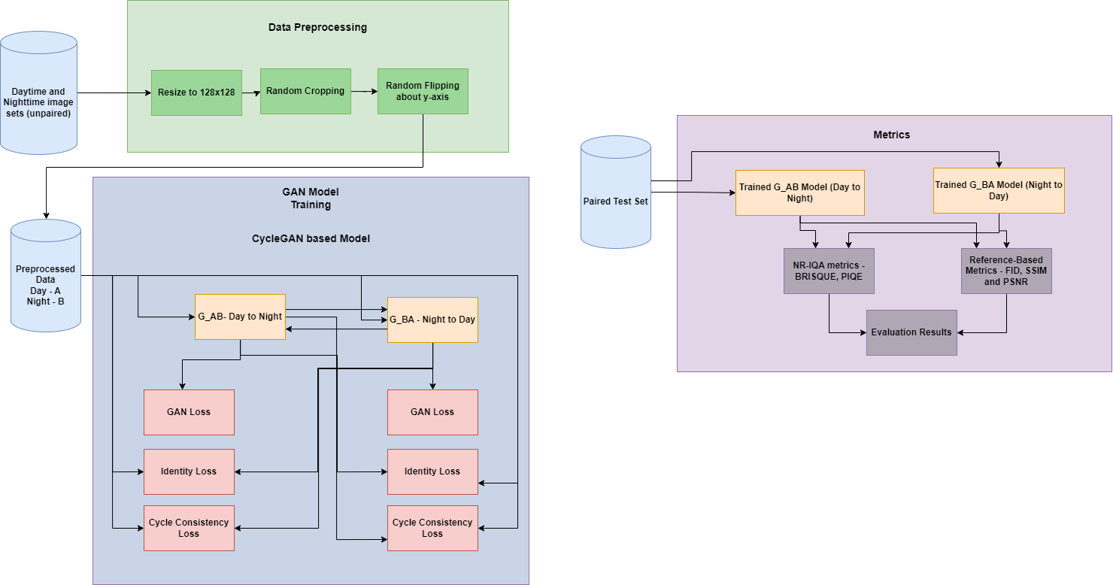
System Design

Slide 7
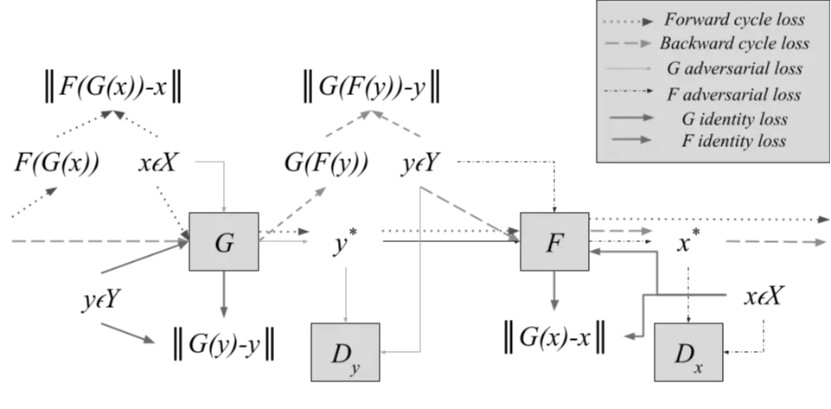
Architecture of Generic CycleGAN Based Network

Slide 8
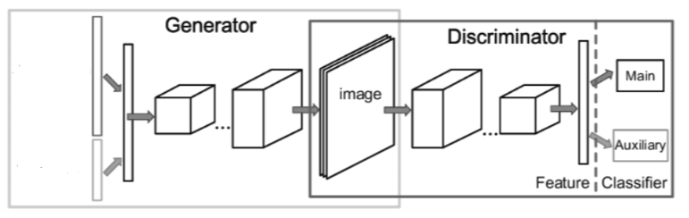
Architecture of Generic CycleGAN Based Network

Slide 9
Novelty
We introduce a WGAN (Wasserstein GAN) based gradient penalty term to the discriminator loss (originally introduced in the DualGAN paper) to the different GAN models - CycleGAN and UNIT GAN with the goal of improving and speeding up the convergence of the model despite not having access to high quality paired training data.
We benchmark the different models to obtain the best performing models and introduce adjustments that speed up model inference times so as to use the model in a real-time environment.
.
We devise a visualization tool for visually perceiving the translation performed by various models.

Slide 10
Modules - Data Collection and Preprocessing
Data Collection: In this work, we have used the Dark Zurich image dataset containing a total of around 5500 images - 3000 of which are day time images and the other 2500 are night time images. The images used from the above mentioned dataset are unpaired images (i.e, the day time and night time image sets are not corresponding image pairs).
The test dataset comprises 50 paired day and night time images. Other datasets available for this purpose are ZJU, BDD100K, and the Oxford Dataset.
Data Preprocessing: The images in the dataset were in 256*256 resolution. To accommodate the data for various models, they were scaled down to 128*128 resolution. To enhance the robustness of the models, Cropped and flipped versions of the original images were introduced into the dataset.

Slide 11
Modules - Model Architecture and Training
Model Architecture
The model architecture was implemented using PyTorch and the generator and discriminator network are composed of a series of convolutional layers and activation layers coupled with normalization layers. Each model comprised of two pairs of generators and discriminators that maintain an adversarial relationship during the training process.
Training Process:
Sample Images: Randomly sample images from both domains (day A and night B).
Generator Update:
Update G_A: Minimize the combined loss (adversarial loss of G_A + cycle consistency loss).
Update G_B: Similar to G_A, minimize its combined loss.
Discriminator Update:
Update D_A: Maximize its ability to distinguish between real and generated images from domain A.
Update D_B: Similar to D_A, maximize its classification for domain B.

Slide 12
Modules - Model Hyperparameters
Hyperparameters:
Hyperparameter | DualGAN | CycleGAN | DiscoGAN | UNIT | ToDayGAN
Batch Size | 8 | 1 | 1 | 3 | 1
LR | 0.0002 | 0.0002 | 0.0001 | 0.0002 | 0.0002
LR Decay Interval | 100 | 200 | 100 | 100 | 50
Image Size | 128 x 128 | 256 x 256 | 128 x 128 | 256 x 256 | 256 x 256
Optimizer | Adam | Adamax | Adamax | Adam | Adam

Slide 13
Modules - Model Testing
Once the models were successfully trained, two no-reference image quality metrics were utilized: BRISQUE - Blind Referenceless Image Spatial Quality Evaluation, and PIQUE - Perceptual Image Quality Evaluation.
The reason for using no-reference metrics is due to the unavailability of perfectly accurate paired ground-truth examples, which, if used, would produce inaccurate results.
However, just to have a different perspective on the model’s performance, the model was considered for testing using the 50 paired testing examples that were collected from the Dark Zurich dataset.

Slide 14
Results and Discussion:
Reference Based Metrics
Model | FID | PSNR (dB) | SSIM
CycleGAN | 42.56 | 48.302 | -0.154
DiscoGAN | 31.74 | 50.988 | -0.157
ToDayGAN | 36.86 | 51.015 | -0.154
UNIT | 45.52 | 50.742 | -0.129
DualGAN | 30.84 | 51.046 | -0.158

Slide 15
Results:
No-Reference Image Quality Assessment metrics
Model | BRISQUE | PIQE
CycleGAN | 10.003 | 24.833
DiscoGAN | 18.283 | 24.767
ToDayGAN | 25.678 | 26.552
UNIT | 29.234 | 20.549
DualGAN | 7.832 | 22.731

Slide 16
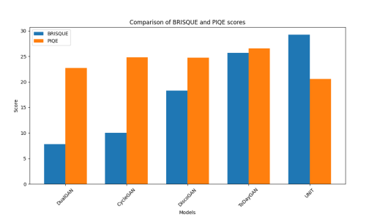
Graphs: Comparison of BRISQUE and PIQE scores

Slide 17
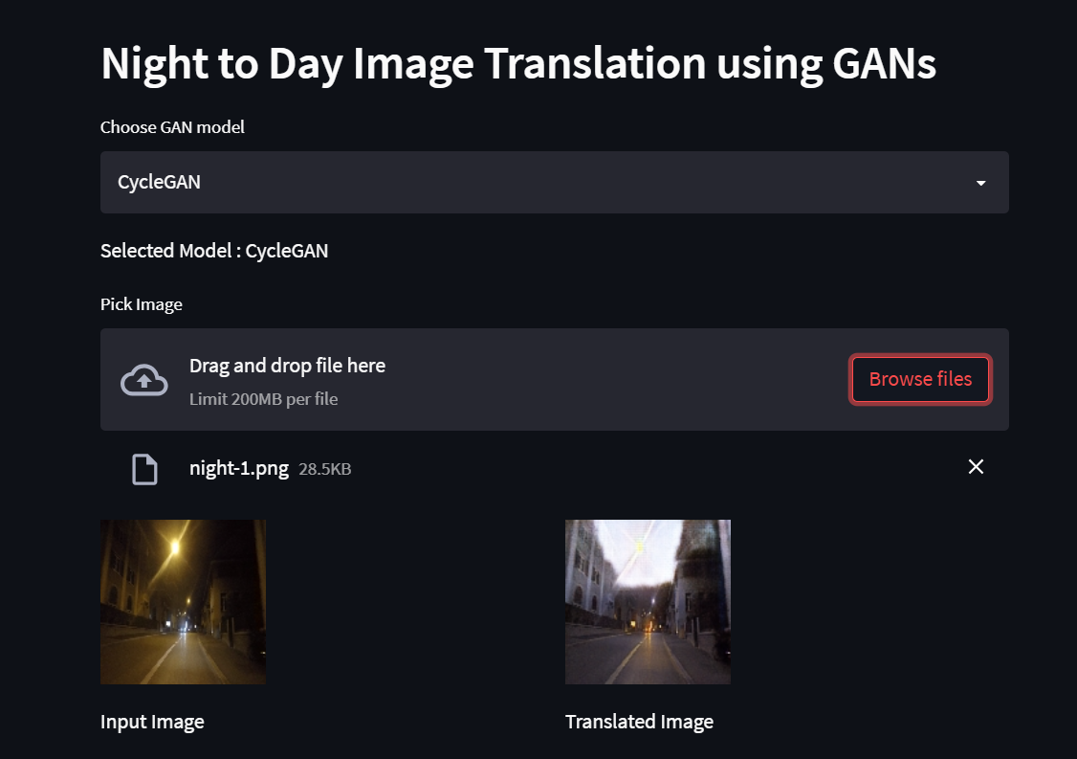
Modules - Model Implementation

Slide 18
Conclusion
The models adjust the color of the sky effectively and enhance overall image brightness and clarity.
Appropriate handling of streetlights and other light sources during translation is observed.
Models accurately translate lane markings, tree shapes, and even retain road reflections.
Foreign objects/structures in the images do not have an impact on the translation process making the model robust and capable of translation of night time scenes in diverse settings.
The translation performed by all of the models we experimented with required a significant amount of computation and also time to translate images from one domain to another.

Slide 19
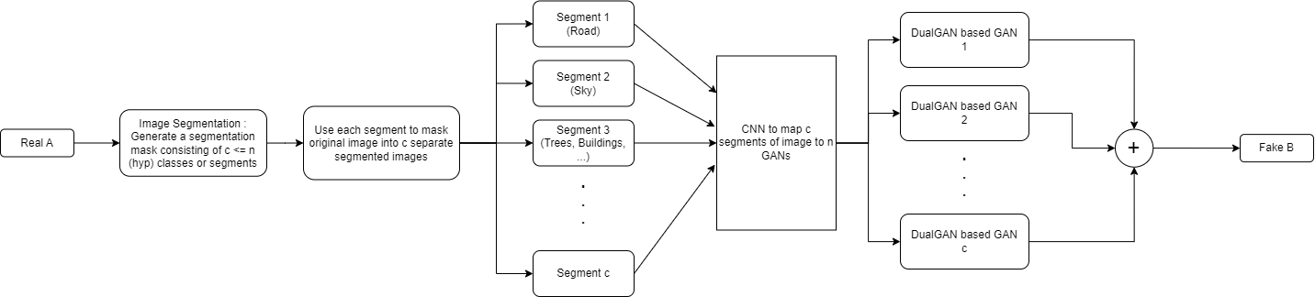
SegmentGAN

Slide 20
Future Scope
The image to image translation models explored have been used in wide ranging applications with satisfactory results. One key challenge is the slow convergence rate experienced during training.
While initial improvements are observed, significant progress often requires extensive training times. This highlights the need for research efforts focused on expediting the convergence process.
Another important area for further exploration lies in capturing and translating low-level image details. While current models produce impressive results, accurately preserving and translating fine-grained features like textures, fine lines, and high-frequency information remains a challenge to be tackled..

Slide 21
References
J.-Y. Zhu, T. Park, P. Isola, and A. A. Efros, “Unpaired image-to-image translation using cycle-consistent adversarial networks,” in Proceedings of the IEEE international conference on computer vision, pp. 2223–2232, 2017.
M.-Y. Liu, T. M. Breuel, and J. Kautz, “Unsupervised image-to-image translation networks,” in Neural Information Processing Systems, 2017.
Z. Yi, H. Zhang, P. Tan, and M. Gong, “Dualgan: Unsupervised dual learning for image-to-image translation,” 2018.
A. Anoosheh, T. Sattler, R. Timofte, M. Pollefeys, and L. V. Gool, “Night-to-day image translation for retrieval-based localization,” 2019.
T. Kim, M. Cha, H. Kim, J. K. Lee, and J. Kim, “Learning to discover cross-domain relations with generative adversarial networks,” 2017.

Slide 22
Findings
Batch Size:
Using a small batch size early in training followed by a gradual increase and then a decrease again leads to better visual quality in the translated images.
Learning Rate:
A learning rate of 0.0002 was found to be optimal for training and the learning rate decay interval was set to 100 initially (and set to 25 after that) to ensure smooth descent into the global minima of the loss surface.
Loss Function:
L1 losses seemed to provide the best results for Identity and Cycle Consistency Losses.
L2 was employed for the GAN loss.
Assigning a very heavy weight for the Cycle Loss results in poorer quality of generated images.

